Slide 1


GPU Programming (in CUDA)
Spring 2019
Julian Gutierrez
Session 1

Slide 2
Outline
Brief Introduction
Syllabus
Introduction to Parallel Computing

Slide 3
Brief Introduction

Slide 4
Who am I
Julian Gutierrez
jgutierrez@ece.neu.edu
PhD Student in Computer Engineering
Worked on algorithm optimization for GPUs for the last ~3 years
Part of the NUCAR Lab

Slide 5
NUCAR
Northeastern University Computer Architecture Research laboratory
Director: Dr. David Kaeli
We do research in many computer engineering areas:
Embedded Systems
Architecture Simulation
GPU Computing
Machine Learning
Many cores
Reliability
Security

Slide 6
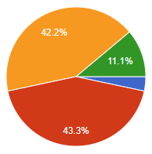
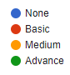
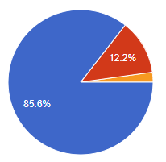
Who are you
C/C++ Programming Experience
Over 90 responses!
CUDA Programming Experience

Slide 7
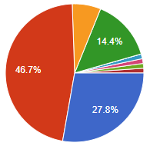
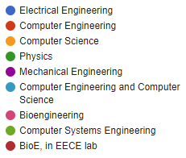
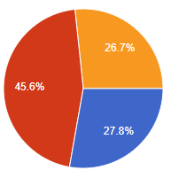

Who are you
Main Program of Study
Over 90 responses!
Current Level of Study

Slide 8
Syllabus

Slide 9
What the class is about
The main idea
Free class where you can learn and interact with GPUs
Learn how to write and design algorithms to develop efficient and high performance programs on GPUs
We will offer a certification for those students who participated in the course as well as a certification for the best performing program for the final project.

Slide 10
Schedule
The course consists of ~13 sessions, 2 sessions per week.
Tuesdays: from 8 pm to 10 pm in Dodge Hall 173
Except February 19th, 26th and March 5th, in Behrakis Health Sciences Center 320 @ 8:10 pm.
Wednesdays: from 8 pm to 10 pm in Dodge Hall 173.
Sunday | Monday | Tuesday | Wednesday | Thursday | Friday | Saturday
January
 |  | 1 | 2 | 3 | 4 | 5
6 | 7 | 8 | 9 | 10 | 11 | 12
13 | 14 | 15 | 16 | 17 | 18 | 19
20 | 21 | 22 | 23 | 24 | 25 | 26
27 | 28 | 29 | 30 | 31
February
 |  |  |  |  | 1 | 2
3 | 4 | 5 | 6 | 7 | 8 | 9
10 | 11 | 12 | 13 | 14 | 15 | 16
17 | 18 | 19 | 20 | 21 | 22 | 23
24 | 25 | 26 | 27 | 28
March
 |  |  |  |  | 1 | 2
3 | 4 | 5 | 6 | 7 | 8 | 9

Slide 11
Schedule
The course consists of ~13 sessions, 2 sessions per week.
Tuesdays: from 8 pm to 10 pm in Dodge Hall 173
Except February 19th, 26th and March 5th, in Behrakis Health Sciences Center 320 @ 8:10 pm.
Wednesdays: from 8 pm to 10 pm in Dodge Hall 173.
Sunday | Monday | Tuesday | Wednesday | Thursday | Friday | Saturday
January
 |  | 1 | 2 | 3 | 4 | 5
6 | 7 | 8 | 9 | 10 | 11 | 12
13 | 14 | 15 | 16 | 17 | 18 | 19
20 | 21 | 22 | 23 | 24 | 25 | 26
27 | 28 | 29 | 30 | 31
February
 |  |  |  |  | 1 | 2
3 | 4 | 5 | 6 | 7 | 8 | 9
10 | 11 | 12 | 13 | 14 | 15 | 16
17 | 18 | 19 | 20 | 21 | 22 | 23
24 | 25 | 26 | 27 | 28
March
 |  |  |  |  | 1 | 2
3 | 4 | Spring Break |  | 7 | 8 | 9

Slide 12
Class Structure
Class | Topics
1 | Introduction / Discovery Cluster / Basics
2 | Lab 0 - Server / Unix Basics
3 | Cuda Execution Model / Architecture and NVVP and NVPROF
4 | Lab 1 - Cuda Execution Model
5 | Cuda Memory Model
6 | Lab 2 - Global Memory
7 | Lab 3 - Shared Memory
8 | Applications (Parallel Reduction, Scan, Histogram, Convolution)
9 | Image Processing
10 | Lab 4 - Image Processing
11 | Advanced Memory Topics: Pinned, Unified. Concurrency and Dynamic Parallelism.
12 | Lab 5 - Advanced Topics
13 | Additional Topics (OpenACC, Modern GPU architecture, Pascal, CUDA 8, CUDNN) and Final Project Presentation

Slide 13
How the class is going to work
Lets have fun, it’s a learning experience for all of us
Bring computers to class. Some days we will be doing hands on labs
The only time you need to dedicate to the class is the actual classes (except if you want to work on the final project)
To receive the final certificate you are required to attend all labs and submit a project.

Slide 14
Final Project
There will be one small final project. The project will consist of a small competition at the end of the course where all students will have to improve the performance of an already existing algorithm provided by the professor.
Project Start: Image Processing Session
Project Deadline: Last Session
Field: Image processing
The fastest (on average) to provide a correct output will receive a certificate of champion.

Slide 15
Piazza
All class resources will be found in piazza
Please register in the group to be able to access the resources
piazza.com/northeastern/spring2019/nugpu101

Slide 16
Hardware Resources
Discovery Cluster
The server that will be used for the class
Dr. David Kaeli is the Sponsor for your access
You will have access to such server to work on the project
We will have a unique partition for us to work on during the lab sessions. More details on this in the first lab session.

Slide 17
TAKE OUT YOUR COMPUTER / PHONES / TABLETS / CALCULATORS
ANYTHING WITH ACCESS TO THE INTERNET

Slide 18
Discovery Cluster
Fill out this form
https://goo.gl/4X4Bp2
I will try to get you all accounts by tomorrow

Slide 19
Connecting to the Discovery Cluster
We will need an SSH connection.
I recommend using Unix Terminal (MAC or Linux).
If using Windows, you could use PuTTY, MobaXterm (recommended) or similar.
We will cover this in our first lab

Slide 20
Connecting to the Discovery Cluster
I highly recommend you read the following document as it specifies how to properly use the Cluster.
This is important if you will use it for other projects as well.
https://docs.google.com/presentation/d/1aKZzL3o5kf_RVm23YTuOLj1LI2DZFlzitA2g9w6axas/edit#slide=id.g412dc120e5_0_0

Slide 21
Introduction to Parallel Computing

Slide 22
The move to multi-core computing
The CPU industry has elected to jump off the cycle-time scaling bandwagon
Power/thermal constraints have become a limiting factor
Clock speeds have not changed
The memory wall persists and multi-core places further pressure on this problem
Microprocessor manufacturers are producing high-volume CPUs with 8-16 cores on-chip
New consumer chip Ryzen from AMD has up to 16 cores
SIMD/vector extensions – SSE (streaming SIMD extensions) and AVX (advanced vector extensions)
Also seeing multi-core in the embedded domain

Slide 23



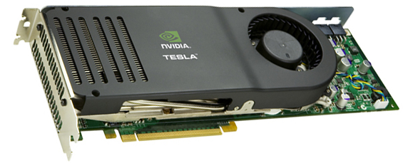


Why are GPUs of Interest?
Graphics Processing Units
More than 65% of Americans played a video game in 2009
High-end - primarily used for 3-D rendering for videogame graphics and movie animation
Mid/low-end – primarily used for computer displays
Manufacturers include NVIDIA, AMD/ATI, Intel (embedded)
Very competitive commodities market

Slide 24
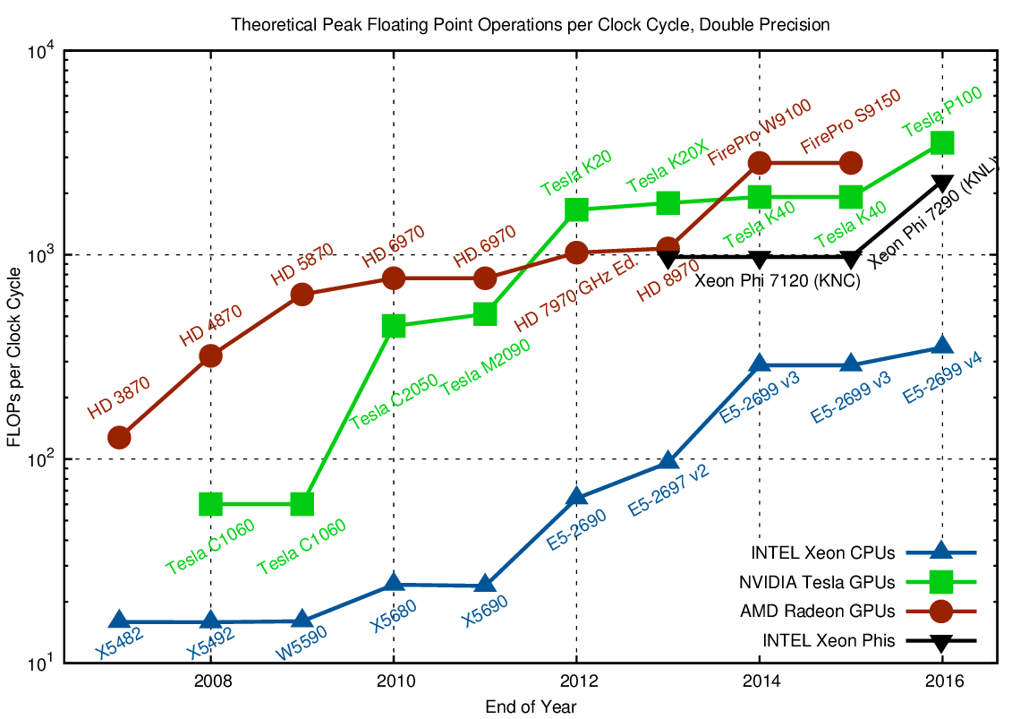
Why are GPUs of Interest?
Performance: CPU vs GPU
Source: Karl Rupp’s website www.karlrupp.net

Slide 25
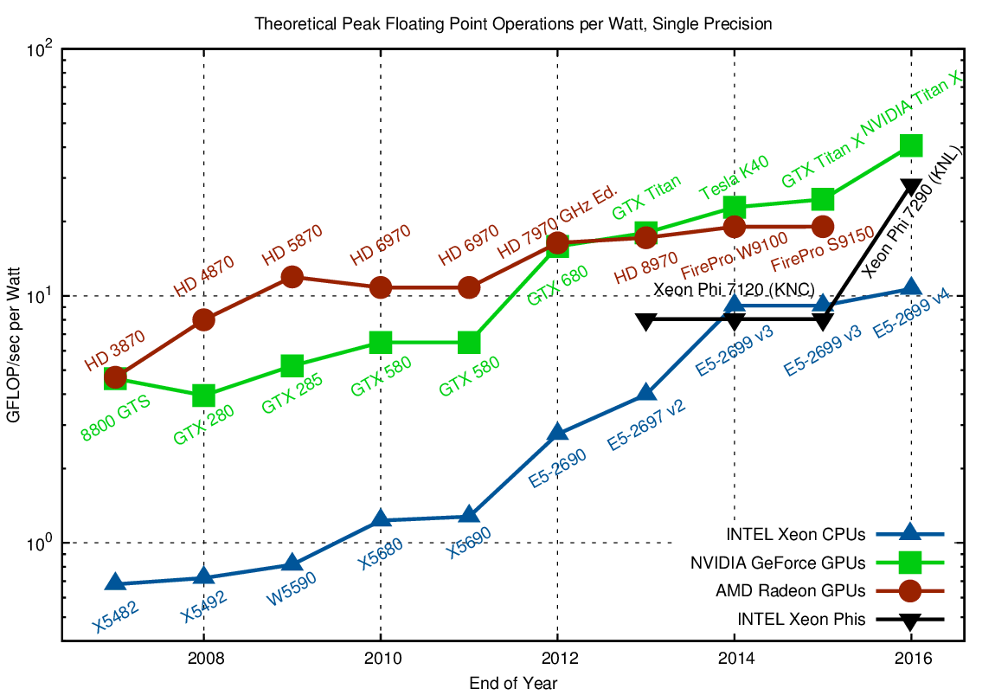
Why are GPUs of Interest?
Performance/Power: CPU vs GPU
Source: Karl Rupp’s website www.karlrupp.net

Slide 26
A wide range of GPU Applications
3D image analysis
Adaptive radiation therapy
Acoustics
Astronomy
Audio
Automobile vision
Bioinformatics
Biological simulation
Broadcast
Cellular automata
Fluid dynamics
Computer vision
Cryptography
CT reconstruction
Data mining
Digital cinema / projections
Electromagnetic simulation
Equity trading
Film
Financial
GIS
Holographic cinema
Intrusion detection
Machine learning
Mathematics research
Military
Mine planning
Molecular dynamics
MRI reconstruction
Multispectral imaging
N-body simulation
Network processing
Neural network
Oceanographic research
Optical inspection
Particle physics
Protein folding
Quantum chemistry
Ray tracing
Radar
Reservoir simulation
Robotic vision / AI
Robotic surgery
Satellite data analysis
Seismic imaging
Surgery simulation
Surveillance
Ultrasound
Video conferencing
Telescope
Video
Visualization
Wireless
X-Ray

Slide 27

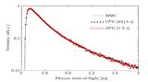


A wide range of GPU Applications
As a General Purpose Computing Platform
Speedups are impressive and ever increasing!
Genetic Algorithm
Monte Carlo Simulation
Of Photon Migration
Lattice-Boltzmann Method
for Numerical Fluid Mechanics
K-Nearest Neighbor
Search
2600 X
1000 X
1840 X
470 X
Source: CUDA Zone at www.nvidia.com/cuda/

Slide 28
Parallel Computing
We want to achieve high performance (HPC)
Improve speed of computation
Two important aspects we should consider for parallel computing:
Architecture
Parallel Programming

Slide 29
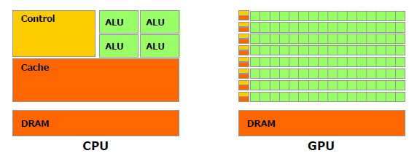
Architecture of a GPU
GPUs have a many-core architecture.
Many-core:
architecture with hundreds or thousands of cores.
CPU: Cache heavy, focused on individual thread performance
GPU: ALU heavy, massively parallel, throughput-oriented
Irregular data accesses
More cache + Control
Regular data accesses

Slide 30
So how do we start writing parallel programs?
When we think of writing code in parallel, there are two ways of tackling this problem.
When we have a shared memory model.
When we have a distributed system model.

Slide 31
So how do we start writing parallel programs?
Shared memory system model
A single contiguous memory address space
Significantly reduces the burden of parallelizing programs
Distributed systems model
Multiple memory address spaces are available
The programmer has the task of issuing explicit communication commands to manage synchronization of tasks and distributed memory

Slide 32
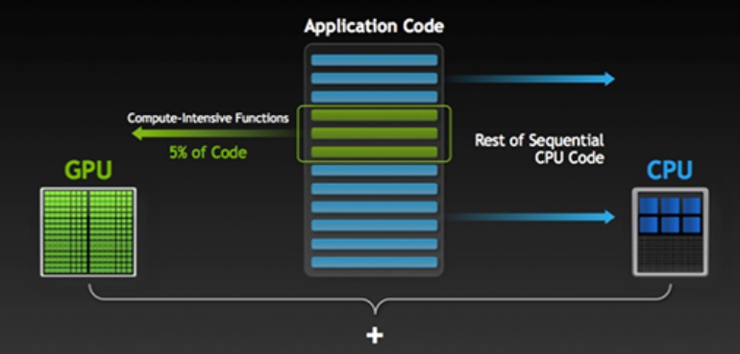
Heterogeneous Architecture
A heterogeneous application consists of two parts:
Host code. Runs on the CPU
Device code. Runs on the GPU

Slide 33
Reasoning about Parallelism
We need to start thinking in parallel
To begin to utilize parallel systems such as multi-core CPUs, many-core GPUs and clusters, you need to understand parallelism
We will explore this with a simple exercise
We will explore some questions that will help you understand the challenges we must overcome to exploit parallel resources

Slide 34

Jigsaw Puzzle
Person A is working on a jigsaw puzzle
It takes A 1 hour to complete the puzzle
Henry Neeman, Lloyd Lee, Julia Mullen, and Gerard Newman. 2006. Analogies for teaching parallel computing to inexperienced programmers. SIGCSE Bull. 38, 4 (June 2006), 64-67.

Slide 35
Jigsaw Puzzle
Now, person B sits across the table from A and works with A on the puzzle.
Lets assume that half the puzzle is grass and the other half is the sky.
If A works on the grass and B on the sky, how long will it take the two of them to complete it?
Henry Neeman, Lloyd Lee, Julia Mullen, and Gerard Newman. 2006. Analogies for teaching parallel computing to inexperienced programmers. SIGCSE Bull. 38, 4 (June 2006), 64-67.
Notes:
Here the participants are lead to offer answers such as half an hour or a little more than half an hour.

Slide 36
Jigsaw Puzzle
If A and B both try to grab a piece out of the pile at the same time, will that slow them down?
What if they grab for the same piece at the same time?
Henry Neeman, Lloyd Lee, Julia Mullen, and Gerard Newman. 2006. Analogies for teaching parallel computing to inexperienced programmers. SIGCSE Bull. 38, 4 (June 2006), 64-67.

Slide 37
Jigsaw Puzzle
Can A and B work completely independently or will they need to work together at the horizon – that is, at the shared interface between their parts?
Henry Neeman, Lloyd Lee, Julia Mullen, and Gerard Newman. 2006. Analogies for teaching parallel computing to inexperienced programmers. SIGCSE Bull. 38, 4 (June 2006), 64-67.
Notes:
These questions lead to a discussion of overhead issues such as contention for shared resources (particularly shared memory) and communication among threads at the shared interfaces between subdomains. The participants are lead to conclude that two workers will take a bit more than half the time of one worker, because of the overhead of contention and ocmmunication

Slide 38
Jigsaw Puzzle
Now suppose that C and D sit at the table as well.
Will there be more contention for the shared resource, or less, or the same?
What about communication at the shared interfaces? How long will it take four people?
Henry Neeman, Lloyd Lee, Julia Mullen, and Gerard Newman. 2006. Analogies for teaching parallel computing to inexperienced programmers. SIGCSE Bull. 38, 4 (June 2006), 64-67.
Notes:
By this time, the issues of contention and communication are becoming clear. The participants are lead to understand that overhead increases as the number of workers increases.

Slide 39
Jigsaw Puzzle
Now suppose that E, F, G and H sit at the table too.
How long will it take the eight of them? If we keep adding people around the table, do we keep speeding up?
Henry Neeman, Lloyd Lee, Julia Mullen, and Gerard Newman. 2006. Analogies for teaching parallel computing to inexperienced programmers. SIGCSE Bull. 38, 4 (June 2006), 64-67.
Notes:
At this stage, the discussion turns to the concept of diminishing returns, and the instructor points out that, in practice, a shared memory parallel program typically will top out in performance at 8 to 32 threads.

Slide 40
Jigsaw Puzzle
Parallelism isn’t always the best way (at least, not straight forward).
We need to understand the resources we have available and understand how to use them together in order to get a benefit in performance.
Henry Neeman, Lloyd Lee, Julia Mullen, and Gerard Newman. 2006. Analogies for teaching parallel computing to inexperienced programmers. SIGCSE Bull. 38, 4 (June 2006), 64-67.

Slide 41
Jigsaw Puzzle
What if we have 8 puzzles to complete now?
Henry Neeman, Lloyd Lee, Julia Mullen, and Gerard Newman. 2006. Analogies for teaching parallel computing to inexperienced programmers. SIGCSE Bull. 38, 4 (June 2006), 64-67.

Slide 42





Parallelizing our lives
Many of the tasks we perform in our everyday lives include significant parallelism
Can you name some of these?
How many of these activities could be carried out concurrently
Identify pairs of parallelizable activities
Shower
Get Dressed
Eat breakfast
Wash our teeth
Dry your hair
Drive to work
Study
Check email
Use cellphone
Do exercise
Socialize
Etc…

Slide 43
Parallelizing our lives
Consider why many of these cannot presently be carried out in parallel
What would need to be changed in our physical world (e.g., showers, cars, Ipods) to allow us to complete many of these activities in parallel
How often is parallelism inhibited by our inability of carrying out two things at the same time?
Estimate how much more quickly it would take to carry out these activities if you could change these physical systems
Shower
Get Dressed
Eat breakfast
Wash our teeth
Dry your hair
Drive to work
Study
Check email
Use cellphone
Do exercise
Socialize
Etc…

Slide 44
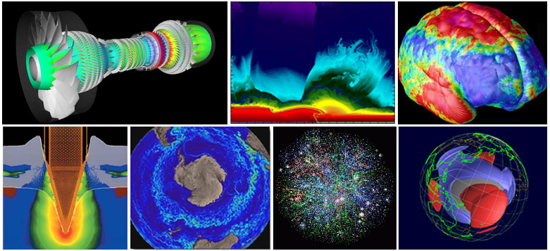
Parallelizing our lives
Our world is completely parallel
There is rampant parallelism in the natural world

Slide 45
Additional Resources
This is a link to a very watchable and informative C++ playlist on Youtube:
https://www.youtube.com/watch?v=tvC1WCdV1XU&list=PLAE85DE8440AA6B83
This website contains many C++ example problems and solutions:
http://www.worldbestlearningcenter.com/index_files/cpp-tutorial-variables_datatypes_exercises.htm
This is a link to a great linux playlist on youtube:
https://www.youtube.com/watch?v=HjuHHI60s44&list=PL6gx4Cwl9DGCkg2uj3PxUWhMDuTw3VKjM
This website contains many Linux examples and tutorials:
http://www.ee.surrey.ac.uk/Teaching/Unix/
And this website has an interactive terminal emulator that allows for safe practicing of commands:
https://www.codecademy.com/learn/learn-the-command-line

